Slide 1
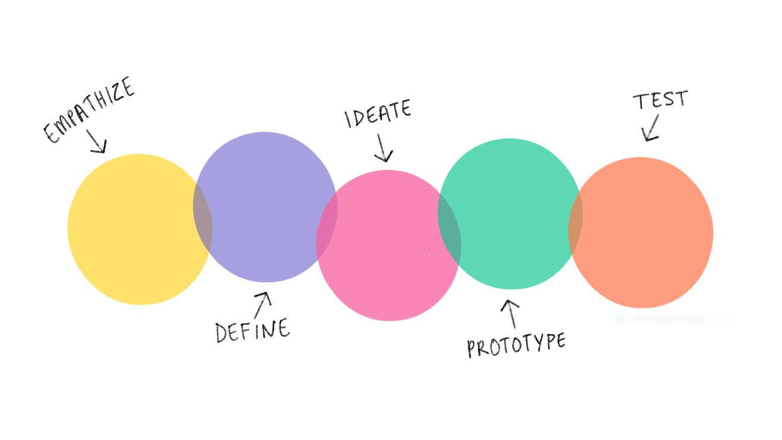
Jarvis x spotify
2
+
2
+
Oz, Luke & Cerys

Slide 2


Jarvis
2
+
2
+
2
+
Who/What is JARVIS?

Slide 3

Jarvis & tony
2
+
2
+
How they interact?
Affordance – relationship between how an object and a user interact
Signifier – communicates the affordance to the user
Feedback – communicates an action you expect to happen as a consequence of the user’s interaction

Slide 4

Speculative design
2
+
2
+
“Unsettle the present”
Addressing big societal problems and looking towards the future

Slide 5

Don norman – The design of everyday things
Design Thinking
Human-centered design (HCD)
Find the root issue
Make multiple solutions
Propose the best solution
“Solving the right problem, and doing so in a way that meets human needs and capabilities”
“A brilliant solution to the wrong problem can be worse than no solution at all”

Slide 6

Spotify
2
+
2
+
History, Competitors, Future

Slide 7

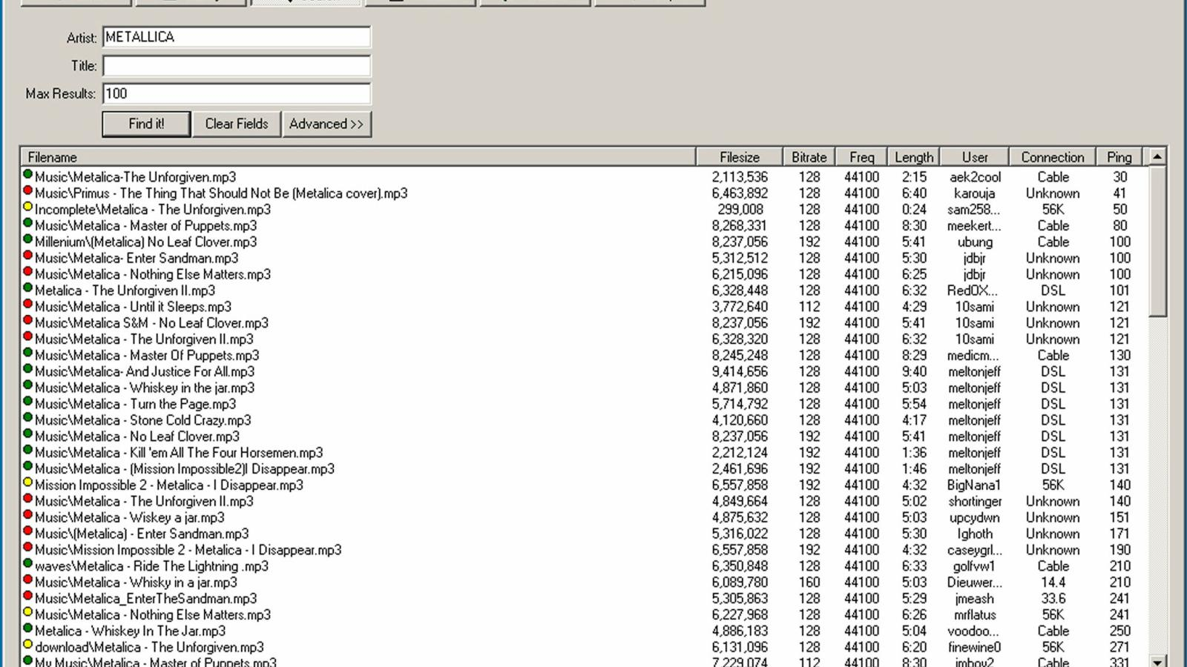
Napster and music services
2
+
Changing the music industry
Developed in 1998
Music became more accessible - download induvial songs instead of buying a whole album
70 million members by 2001
CD stores lost revenue and shut down
Itunes founded in 2003 – made distribution easier and cheaper

Slide 8
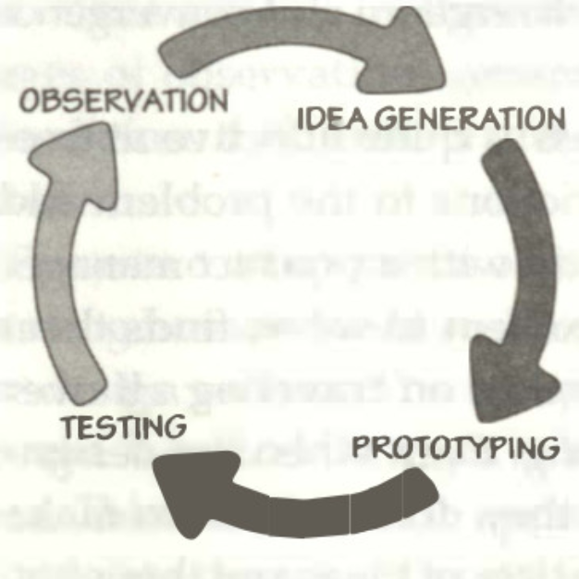
Founding
Speculative Design
Founded in 2006
Streaming service
Provided a solution for music records which were suffering from illegal downloads
Only available in 6 large European Countries on launch
Went through a lot of prototypes/trials before going onto other countries for full release
The iterative cycle of human design – Design of Everyday Things – Don Norman

Slide 9
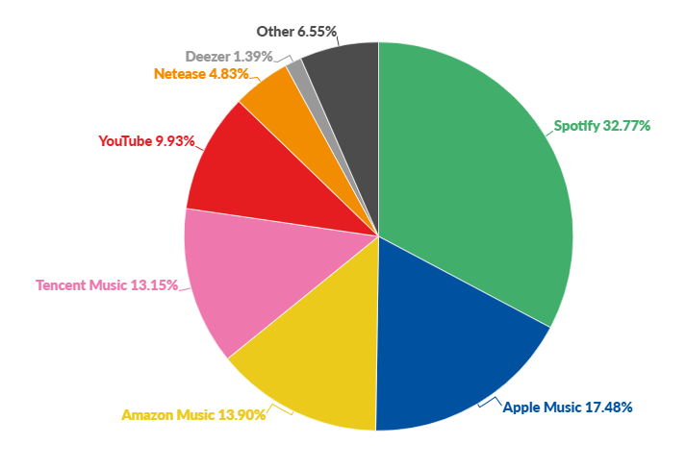
competitors
Revenue/Problems
Main Competitors: Apple Music, YouTube Music & Amazon Music.
Majority of revenue from subscriptions.
Free version brings revenue through Ads
Spotify as a Monopoly:
What is a Monopoly?
A company or business having exclusive control over a specific service.
Strong monopoly shown through monthly listeners
Also holds a monopoly over the “new” concept of ‘Streaming music on the Go’.

Slide 10

Future plans
2
+
How can it stay number one?
Needs to stay on top of the industry
Newly introduced: Podcasts of all kinds (learning, languages, entertainment etc.)
The service requires expansion to uphold its monopoly of music streaming services.

Slide 11

Any questions?
2
+
2
+

